Slide 1
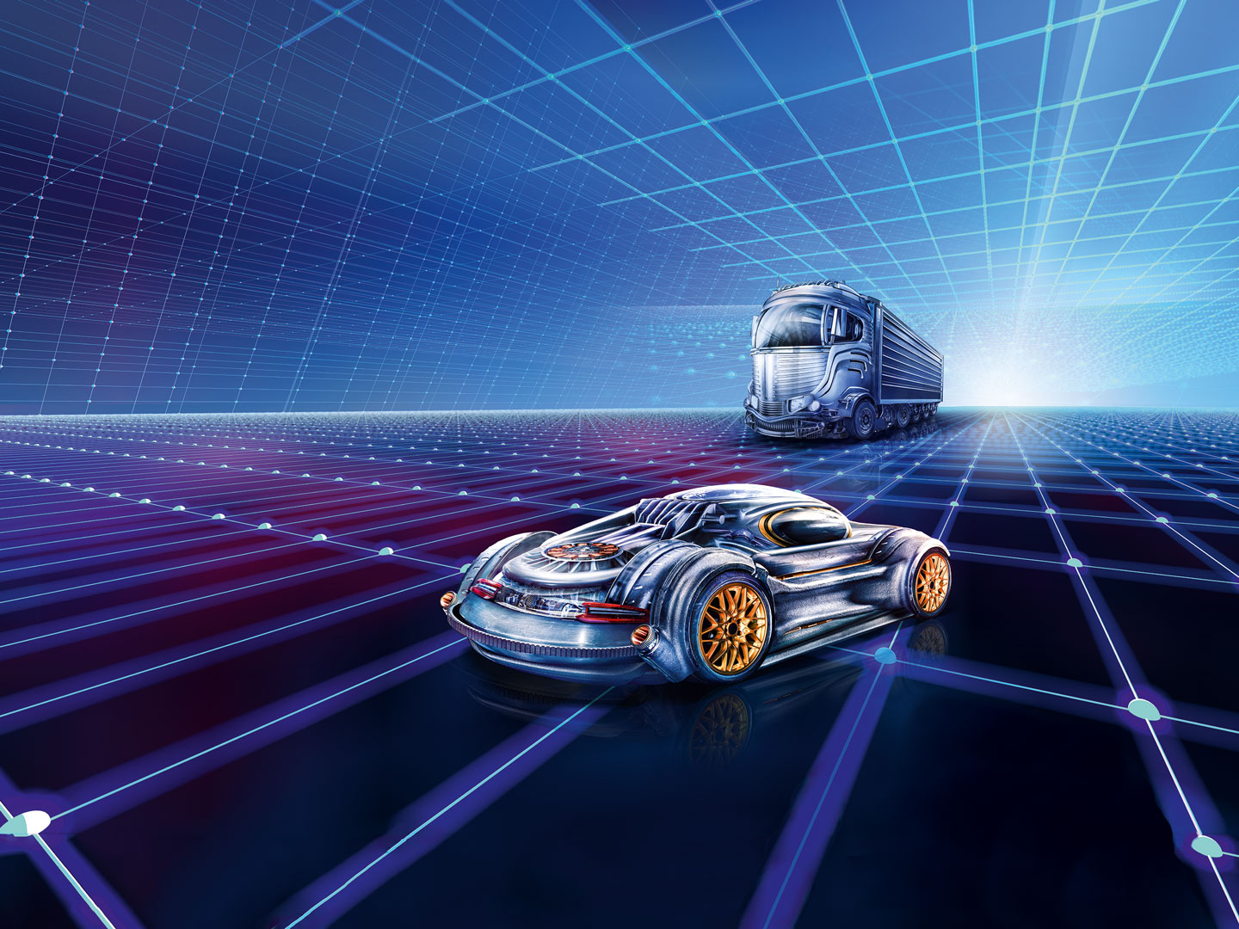

AUTOMECHANIKA INDIA
www.techsciresearch.com
MARKET INTELLIGENCE. CONSULTING

Slide 2
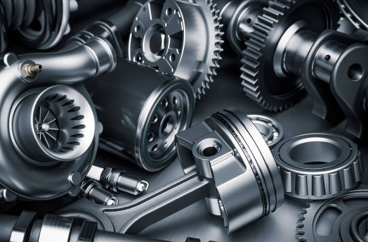
FY 2022
INDIA AUTOMOTIVE AFTERMARKET
www.techsciresearch.com
MARKET INTELLIGENCE. CONSULTING

Slide 3
India Automotive Aftermarket Share, By Part Type
India Automotive Aftermarket Share, By Part Type, By Value, FY2022
Other Includes:*Steering system hard parts, Remanufactured engine and transmission, remanufactured rack and pinion steering gear, Heating Ventilation and Air Conditioning (HVAC) and engine cooling components, light vehicle exhaust emission control systems, fuel-delivery systems, engine control units, ignition parts, automotive sensors, ignition wire sets, fuel pumps, selected automotive remanufactured pumps, sports compact underhood components, belt, hoses, gaskets and seals, battery, carburetor, gauge, and internal engine hard parts
Source: TechSci Research
Overall Aftermarket Value | USD 13.41 Billion

Slide 4
India Automotive Aftermarket Share, By Trade
India Automotive Aftermarket Share, By Trade, By Value, FY2022
Source: TechSci Research
India’s Automotive aftermarket was valued at USD 13.41 billion in FY 2022, including about USD 4.2 billion in imports.

Slide 5

MARKET DYNAMICS

Slide 6
Market Drivers
The need for more fuel-efficient, automobiles has increased the demand for aftermarket components like electronic chips and catalytic converters. Owners' keen interest in upgrading their older vehicles with new features is a major factor in the expansion of the automotive aftermarket sector.
Original equipment manufacturers have continuously increased their level of engagement and attention within the automotive parts aftermarket value chain, for example by establishing their networks of repair facilities that aren't dedicated to any car brand. In order to compete with independent aftermarket companies and keep clients within their networks for a longer period of time, major market participants have created second service formats, second brands, or remanufactured parts. By utilizing vehicle connection, for example, to keep customers and automate service and repair decision-making, OEMs are also investing in customer experience optimization initiatives and developing differentiated aftermarket service options.
The aftermarket service is used to upgrade the existing automobiles with new parts or to repair a damaged item in a vehicle. Various parts of the clients' automobiles need to be changed at predetermined intervals. For example, depending on driving conditions, passenger automobiles need to replace their tyres every 3–4 years. Consequently, there is a sizable aftermarket for vehicle parts. Additionally, the aftermarket is expanding as a result of consumer preferences for installing cutting-edge automotive components to enhance vehicle look and ensure driver safety. Customers' greater propensity to buy aftermarket services fuels the expansion of the automobile aftermarket, which is anticipated to occur in the near future.
1
Rise in technological advancement
2
Rapidly Expansion of OEMs
3
Rising Post sale services

Slide 7
Market Challenges
The phrase "counterfeit components" describes replicas of parts from well-known brands. The vendors don't follow the standards or employ a uniform testing technique, even though that the parts are supplied in the unorganised sector under brand names. This creates a big barrier in the Indian aftermarket. A few manufacturers have developed parts with holographic sealing in response to the problem of counterfeit components.
The highly distributed Indian service network ecology is dominated by independent workshops. The IAM is facing a variety of difficulties, such as developing the necessary infrastructure, enhancing skill sets to accommodate contemporary technologies, and gaining technical expertise, which contains concerns about the calibre of services. With increasingly modern cars, this issue will result in more OES channel alternatives.
The aftermarket is expected to experience some fascinating consequences of this change in the auto business. While brake pads may take longer to wear out in electric vehicles than in conventional ones, tyres are used more quickly. Additionally, aftermarket manufacturers and distributors will need to adapt as in-car systems become more complex, including sophisticated heating and cooling systems, advanced driver assistance features, and other features, not only in terms of their product offerings but also in how they train their sales force.
Pe
Lacking Substantial Independent Service Chains
Aftermarket Counterfeit Parts and the Unorganized Sector
Shifting in Technology

Slide 8

MARKET TRENDS AND DEVELOPMENTS

Slide 9
Market Trends and Developments
Improve in Product development Capabilities
To meet the quality product standard, companies are expanding their spending in establishing up R&D operations and laboratories to execute tasks like analysis, simulation, and engineering animations. Additionally, the expansion of global OEM sourcing from India over the past several years and the increasing indigenization of global OEMs are making the nation a desirable location for designing and manufacturing. Nitin Gadkari, Minister of Road Transport and Highways, requested that flex-fuel vehicle production begin within the next six months in December 2021. ZF, a prominent manufacturer of German automotive components, opened and extended its new Tech centre in India in June 2022.In March 2022, Minister of State for Power and Heavy Industries Mr. Krishan Pal Gurjar, said that Indian and foreign automobile manufacturers have taken initiatives to develop hydrogen fuel cell vehicles.
1
Growing Popularity of E-commerce Platform
The lack of domestically produced items, low prices, market participants' consumer-focused targeting, and higher-quality goods have all contributed to the expansion of the e-commerce sector. Additionally, e-commerce enables OEMs with a chance to sell their goods directly to customers, relieving them of the troublesome supply chain, and provides SMEs with numerous benefits for business growth and globalization. Global utilization of the e-commerce logistics sector will increase as the rising country's index of digital service acceptance rises. An international indicator called the "Digital Service Adoption Index" tracks how many sectors of society—including business, government, and the general public—have adopted digital technology. Organizations can thrive in a world where technology is widely used thanks to the efficiency and connectivity that digital technologies offer.
2
Rise in Investment
3
In February 2022, the government has received investments proposal worth USD 6.04 billion (Rs. 45,016 crore) from 20 automotive companies under the PLI Auto scheme. By this scheme it is expected to create an incremental output of USD (31.08 billion (Rs. 2,31,500 crore).Moreover, in December 2021, Tata Motors has lined up investments worth more than US$ 1 billion in the next 4-5 years for its commercial vehicle business. Also, German Auto component major ZF has doubled down on India with an investment of USD 214.10 Billion.

Slide 10
Import Analysis
Key Products Import Analysis
Product | Reporting Country | Prominent Importing Country
Brakes | India | Germany, China, South Korea, United States, Italy
Tires | India | Thailand, China, Indonesia, Malaysia, Vietnam, Japan
Lubricants | India | United States, Singapore, China, Germany, France
Batteries | India | China, Thailand., Sweden, Vietnam, United States, Japan
Filter | India | Japan, China, France, South Korea, Singapore, Germany
Starter/Alternators | India | China, Indonesia, Japan, South Korea, Thailand, Germany
Spark Plugs | India | China, Thailand, Japan, Vietnam, South Korea
Lighting | India | China, South Korea, Japan, Germany, Phillipines
Source: TechSci Research

Slide 11
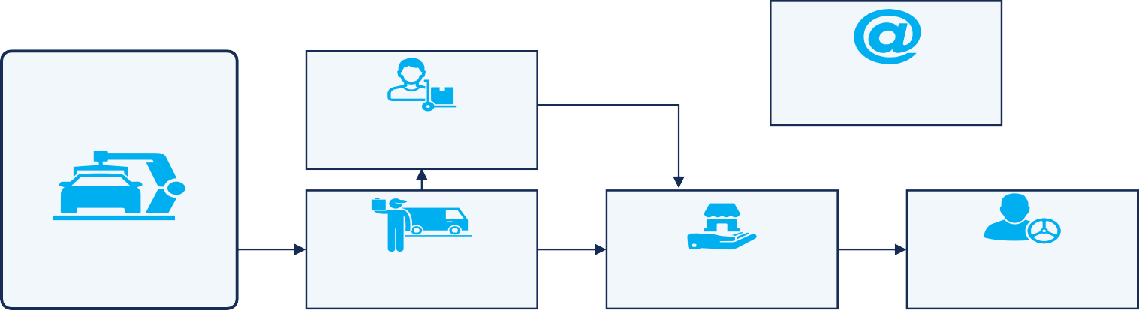
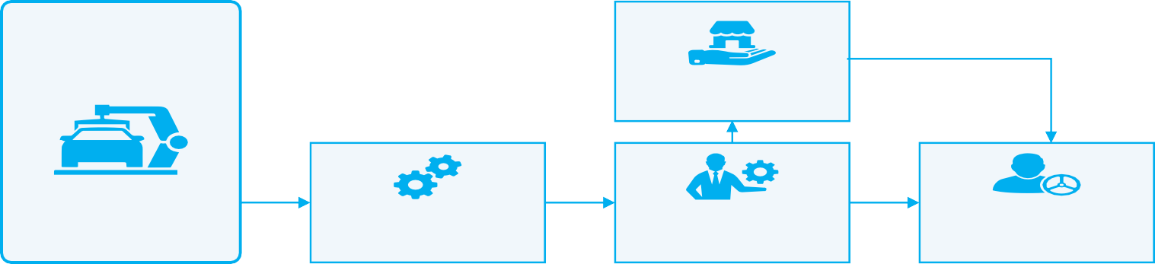
Parts Manufacturers
eRetailers
Wholesalers
IAM
Distributors
Retailers
Installers/ Vehicle Owners
Parts Manufacturers
ASC
OES
OEM
OE
Dealers
Installers/ Vehicle Owners
Direct eRetail
11

